Slide 1

EDP Presentation
Project 2 Findings

Slide 2
Outline of Content
Pre-Processing
Considerations in design
The Classifier
Performance
Limitations
Improvements
Questions

Slide 3
Pre-Processing Why are we Missing Data? Handling Nan Values
Removing Nan
Imputing values
Good when we have lots of data or if a row contains a lot of Nan values.
Bad when the dataset is incomplete, and a large portion of the rows have missing values.
Can create Bias if the dataset has Nan values that are due to outside influence.
Good for handling data that has scattered Nan values
Bad if the Nan values are due to outside influences.
Creates bias depending on method used.

Slide 4
Mean vs Median imputation
Choose the method depending on the type of data, and whether or not the data has outliers.
Median imputation preserves median and Mean imputation preserves mean.
If data has lots of outliers use median imputation.
If data is well formed use mean imputation.
For my classifier used median imputation with mean centred.
Difference between mean and median imputation on the yeast dataset was small.
Chose this since we had other classifiers to compare mine with later

Slide 5
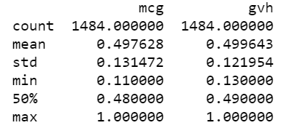
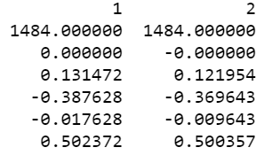
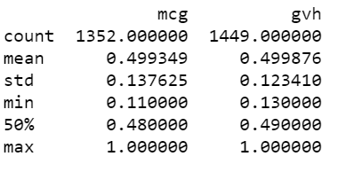
Mean centred
Subtracts a value from each point so that the mean becomes 0
This allows for easier interpretation since 0 is now in our dataset
Left: Median imputed, Middle: median imputed & mean centred
Right: Original

Slide 6
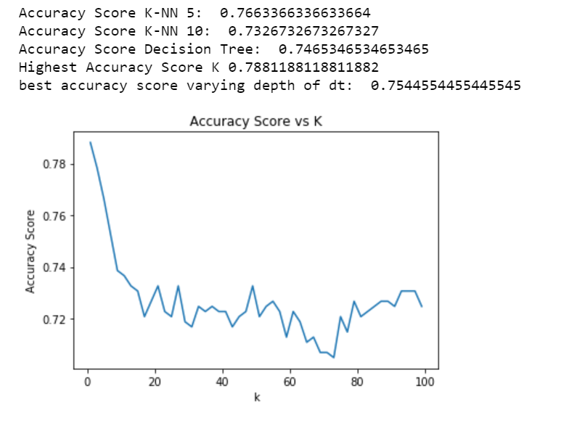
Designing the Classifier
Considered two types of Classifiers with and without feature engineering
k-NN vs Decision Tree
Choose k-NN as it outperforms the Decision Tree

Slide 7


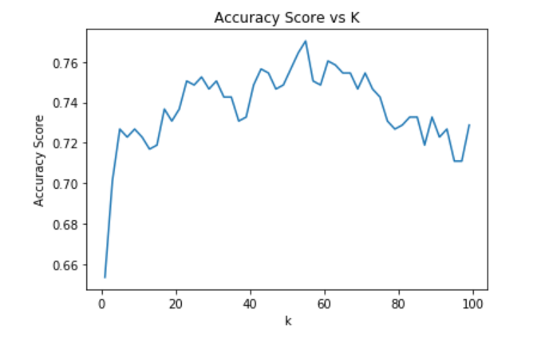
Feature Engineering
Cluster labels vs Interaction
Figure: k-NN with feature engineering
Tested interaction by seeing how much mutual information was gained.

Slide 8
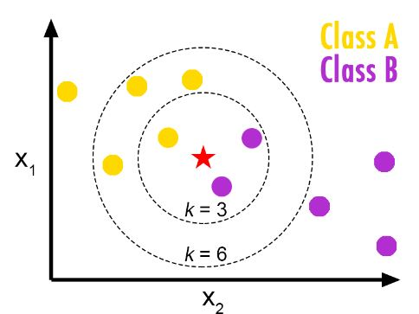
How k-NN based classifier works
Find the k nearest neighbours of the point you want to classify.
Remarks:
Choose odd K value for 2 class problem
Don’t Use K that’s a multiple of the number of classes
Main issue with k-NN is the complexity in searching for nearest neighbours (On large Datasets)

Slide 9
Parameters of classifier
K is the only parameter that can be varied (with ease)
Impact of K:
K too large, data is classified into the majority class
K too small, highly variable, unstable decision boundary. Small changes to training set brings large changes in classification
Selecting K:
Create validation set (from a portion of training data), vary k and observe training. This can lead to validation error
Take k to be the square root of n (give or take 1)
I took k = 5, performed better than other k’s
Can also change features which model is based on i.e which interaction pairs to include.

Slide 10
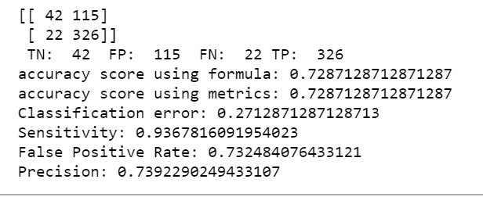
Performance
Classification Accuracy: Overall, how often is the classifier correct?
Classification Error: Overall, how often is the classifier incorrect?
Sensitivity: When the actual value is positive, how often is the prediction correct?
Specificity: When the actual value is negative, how often is the prediction correct?
False Positive Rate: When the actual value is negative, how often is the prediction incorrect?
Precision: When a positive value is predicted, how often is the prediction correct?
The type of data that we have doesn’t require anything except that the classifier is correct. So we value accuracy the most.

Slide 11
Generalizing & Limitations
The classifier would likely maintain a decent accuracy if applied to other datasets.
Main influences on accuracy would be due to the imputation that was required. If the new Dataset was complete there would be some bias from the initial imputation which could cause a loss in accuracy. Likewise if the data required lots of pre-processing, we may see accuracy go either way.
Limitations:
Optimal number of neighbors?
Missing Value treatment
Outlier sensitivity due to neighbour based algorithm
Imbalanced data causes problems
K-NN slows with size; as dataset grows efficiency of algorithm declines very fast.

Slide 12
Improvements & better classifier
Improvement can be made in the selection of the interaction pairs to include in the model. Find a better measure than mutual information to test for interaction significance.
Performance of a better classifier
Multilayer Feed-forward Neural Networks and Supervised Learning.
A feedforward neural network is an artificial neural network wherein connections between the nodes do not form a cycle.
This class of networks consists of multiple layers of computational units, usually interconnected in a feed-forward way. Each neuron in one layer has directed connections to the neurons of the subsequent layer.
http://citeseerx.ist.psu.edu/viewdoc/download?doi=10.1.1.2.4228&rep=rep1&type=pdf
Aristoklis D. Anastasiadis, George D. Magoulas, and Xiaohui Liu

Slide 13

Questions?

